Slide 1
Time dependent DEs
PHYS3112 – Tutorial 6

Slide 2
Today we will:
Solving the heat equation by stepping forward in time
Solving the heat equation using Crank-Nicholson method
Solving the Time Dependent Schrodinger Equation

Slide 3
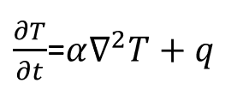
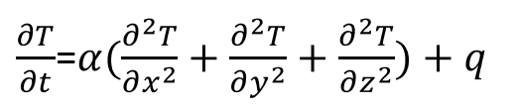
Space AND Time?
The heat equation, which gives us the distribution of temperature throughout a continuous body, has a spatially varying and temporally varying component:
This is going to be a bit of a challenge to model! We will need to adopt a slightly more complicated method than our 1D Poisson matrix from last week.

Slide 4
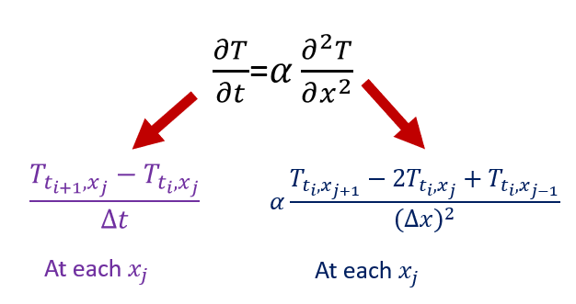
The strategy:
We are very fortunate that time only goes forwards. This means that we can develop an iterative method that solves for all spatial co-ordinates first (via a tri-diagonal matrix), and then steps forward in time.
We will get two equations: one for moving forward in time, the other for space

Slide 5
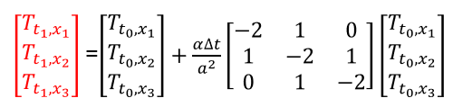

Regular stepping solution Time evolution
It should be noted that this method becomes unstable when $Δt$ becomes too big

Slide 6
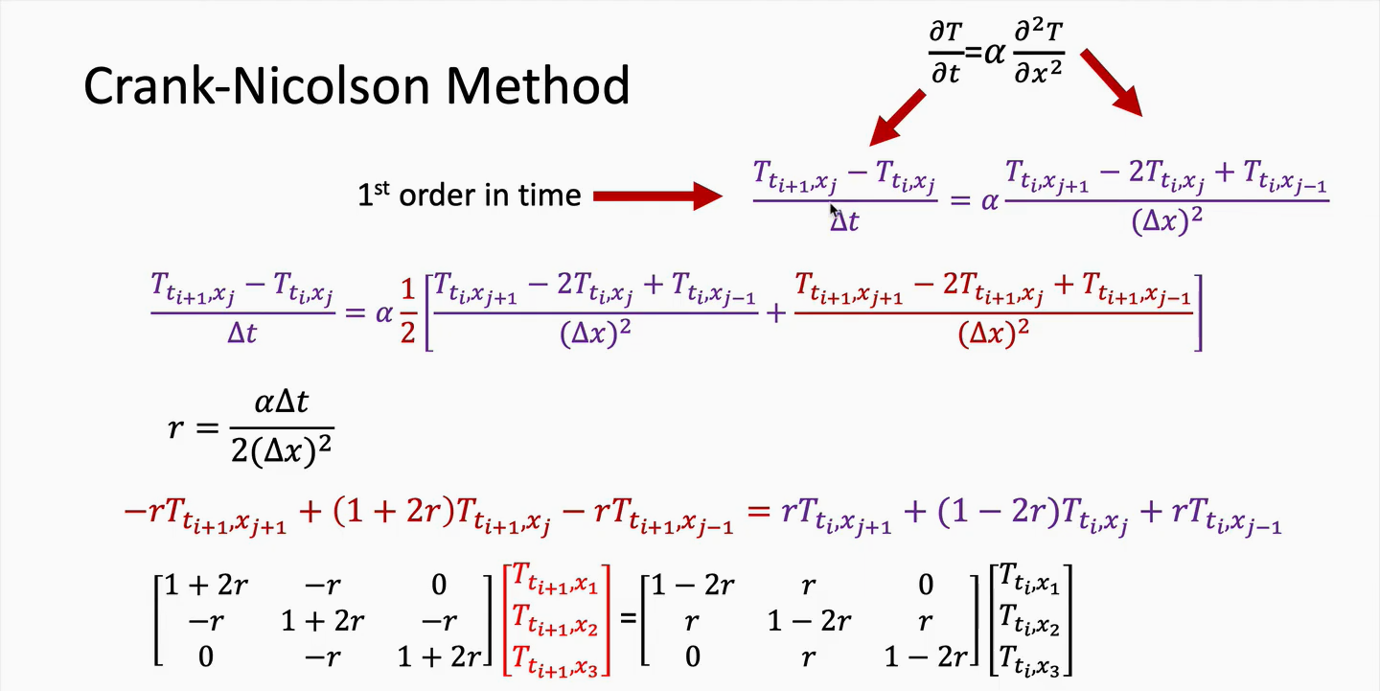

Slide 7


The Crank-Nicolson method.
A
X
B
Solution? With T(ti), compute both matrixes (front and back), and then:
Combine the back matrix and vector into a single vector leaving it in the form: $AX=B$
Solve for T(t i+1) with linalg.solve.
Note linalg.solve is ok for 3x3 matrix but becomes inefficient for larger cases, better to use the Thomas algorithm.

